Slide 1
The Celebritries Quiz Game Fr Marco’s Favourite Game

Slide 2
The Celebritries Quiz Game Fr Marco’s Favourite Game

Slide 3
The Celebritries Quiz Game Fr Marco’s Favourite Game

Slide 4
The Celebritries Quiz Game Fr Marco’s Favourite Game

Slide 5
The Celebritries Quiz Game Fr Marco’s Favourite Game

Slide 6
The Celebritries Quiz Game Fr Marco’s Favourite Game

Slide 7
The Celebritries Quiz Game Fr Marco’s Favourite Game

Slide 8
The Celebritries Quiz Game Fr Marco’s Favourite Game

Slide 9
The Celebritries Quiz Game Fr Marco’s Favourite Game

Slide 10
The Celebritries Quiz Game Fr Marco’s Favourite Game

Slide 11
The Celebritries Quiz Game Fr Marco’s Favourite Game

Slide 12
The Celebritries Quiz Game Fr Marco’s Favourite Game

Slide 13
The Celebritries Quiz Game Fr Marco’s Favourite Game

Slide 14
The Celebritries Quiz Game Fr Marco’s Favourite Game
T

Slide 15
The Celebritries Quiz Game Fr Marco’s Favourite Game

Slide 16
The Celebritries Quiz Game Fr Marco’s Favourite Game

Slide 17
The Celebritries Quiz Game Fr Marco’s Favourite Game

Slide 18
The Celebritries Quiz Game Fr Marco’s Favourite Game

Slide 19
The Celebritries Quiz Game Fr Marco’s Favourite Game

Slide 20
The Celebritries Quiz Game Fr Marco’s Favourite Game

Slide 21
The Celebritries Quiz Game Fr Marco’s Favourite Game

Slide 22
The Celebritries Quiz Game Fr Marco’s Favourite Game

Slide 23
The Celebritries Quiz Game Fr Marco’s Favourite Game

Slide 24
The Celebritries Quiz Game Fr Marco’s Favourite Game

Slide 25
The Celebritries Quiz Game Fr Marco’s Favourite Game
1) Saint Alban
2) Taylor Swift
3) Saint Joan of Arch
4) Elon Musk
5) Saint Thomas Becket (of Canterbury)
6) Rihanna
7) Saint Therese of Lisieux
8) Tom Cruise
9) Saint John Henry Newman
10) Scarlett Johansson
11) Saint Bridget of Sweden
12) David Beckham
13) Saint Anthony of Padua
14) Angelina Jolie
15) Saint Clare of Assisi
16) Dwayne Johnson (The Rock)
17) Blessed Carlo Acutis
18) Arianna Grande
19) Saint Lucy
20) Fr Marco Salvagnini

Slide 26
Why have I been chosen?
Whether you have got a high score or a low score, your life is far more worthy than the one of any celebrities you wish to emulate. You are precious and amazing in the eyes of God. Indeed, He has called and chosen you to be a saint. You are CHOSEN!

Slide 27
Why have I been chosen?
FATHER,... this is eternal life, that they may know you, the only true God, and Jesus Christ whom you have sent. God our Saviour desires all men to be saved and to come to the knowledge of the truth. There is no other name under heaven given among men by which we must be saved.

Slide 28
Why have I been chosen?
God, infinitely perfect and blessed in himself, in a plan of sheer goodness freely created man to make him share in his own blessed life. For this reason, at every time and in every place, God draws close to man. He calls man to seek him, to know him, to love him with all his strength. He calls together all men, scattered and divided by sin, into the unity of his family, the Church.

Slide 29
Why I have been chosen?
To accomplish this, when the fullness of time had come, God sent his Son as Redeemer and Saviour. In his Son and through him, he invites men to become, in the Holy Spirit, his adopted children and thus heirs of his blessed life.

Slide 30
Why have I been chosen?
So that this call should resound throughout the world, Christ sent forth the apostles he had chosen, commissioning them to proclaim the gospel: "Go therefore and make disciples of all nations, baptizing them in the name of the Father and of the Son and of the Holy Spirit, teaching them to observe all that I have commanded you; and lo, I am with you always, to the close of the age.

Slide 31
Why have I been chosen?
Strengthened by this mission, the apostles "went forth and preached everywhere, while the Lord worked with them and confirmed the message by the signs that attended it. Those who with God's help have welcomed Christ's call and freely responded to it are urged on by love of Christ to proclaim the Good News everywhere in the world. This treasure, received from the apostles, has been faithfully guarded by their successors. All Christ's faithful are called to hand it on from generation to generation, by professing the faith, by living it in fraternal sharing, and by celebrating it in liturgy and prayer.

Slide 32
Why do I have to go to mass?

Slide 33
Why do I have to go to mass? Activity 1 (7 Minutes)
Read the following story: For Better or, for…Bored? Then ask yourself this question: Why do I have to go mass?
Answer frankly to this question and then share thoughts with your group’s companions.

Slide 34
For Better, or for ...Bored?
Imagine you’re sitting in math class, and someone raises his or her hand to tell the teacher, “I’m bored.” How would the teacher respond? “Oh, sorry, I wasn’t aware that my job was to put on a show for you. Perhaps I should show up in a clown costume tomorrow to teach you about exponents!” Not likely, right? There are some situations that aren’t supposed to be entertaining ... and yet the word “bored” doesn’t really fit either. Imagine a man leaning back in his chair after dinner and saying to his wife, “Being married to you is getting boring. Entertain me.” I don’t imagine that would end well.

Slide 35
For Better, or for ...Bored?
Or think about what would happen if a man presented a woman with a ring and asked for her hand in marriage ... and she yawned in response. That would be much worse than a simple, “No, I won’t marry you,” right? Now imagine someone being willing to die so that you might live. After the life-saving sacrifice was complete, imagine turning to your parents and saying, “I’m bored. Can we go home now?” Crazy, huh? At every Mass, we remember Jesus’ saving death for us and celebrate his Resurrection, a victory over death itself! At every Mass, he offers all of this to us. If you’re thinking in terms of entertainment, you’re missing the point. This week, we’ll take a closer look at the miracle of the Mass.

Slide 36
Why do I have to go to mass?
Once you have finish to discuss read the following slides

Slide 37
Why do I have to go to mass?
The fathers of the Second Vatican Council referred to the Eucharist as ‘’the source and summit of the Christian life’’, that from which authentic Christianity flows and that towards which it tends.
“When the hour came, Jesus and his apostles reclined at the table. And he said to them, ‘I have eagerly desired to eat this Passover with you before I suffer. For I tell you, I will not eat it again until it finds fulfillment in the kingdom of God.’ After taking the cup, he gave thanks and said, ‘Take this and divide it among you. For I tell you I will not drink again from the fruit of the vine until the kingdom of God comes.’ And he took bread, gave thanks and broke it, and gave it to them, saying, ‘This is my body given for you; do this in remembrance of me.’ In the same way, after the supper he took the cup, saying, ‘This cup is the new covenant in my blood, which is poured out for you.’ ” —(Luke 22:14-20)

Slide 38
Why do I have to go to mass?
‘’I tell you most solemnly, if you do not eat the flesh of the Son of Man and drink his blood, you will not have life in you. Anyone who does eat my flesh and drink my blood has eternal life, and I shall raise him up on the last day. For my flesh is real food and my blood real drink. He who eats my flesh and drink my blood lives in me and I live in him. As I, who am sent by the living Father, myself draw life from the Father, so whoever eats me will draw life from me. This is the bread come down from heaven; not like the bread our ancestors ate: they are dead, but anyone who eats this bread will live for ever.’’ (John 6:53-38)

Slide 39
Activity 2 (7 minutes)
Reflect and share on these two Scripture passages that you have just read. Does anything strike you?
Write down your considerations and share them with your companions.

Slide 40
Reflect and Discuss (17 minutes)
Watch the Video 15.1 (from minute 1.55 onwards)[10 minutes] and then Answer to the following questions privately and then discuss within the members of your group: [7 minutes]
What does it mean the Mass for you?
Do you come to mass willingly or unwillingly? Why?
Why do you think so many people fail to make Mass a priority? Many say they “don’t get anything out of it.” What should a faithful Catholic “put into it”?

Slide 41
Reflect and Discuss (23 minutes)
Watch the Video 15.2 e Video 15.3 and answer to the following questions privately and then discuss within the members of your group:
Jesus gives us himself in the Eucharist. Why? What impact can that have in our lives? How do you feel during Mass?
What is the Eucharist in your own words?
In every Mass we can encounter God from beginning to end. What are some ways we can actively seek to encounter God at Mass? What are some things that distract you? What parts do you find more engaging?
According to you Why does the Church require us to attend Mass every Sunday?

Slide 42
Time to have a break
We are going to have a five minutes break if you need to go to the wet room or outside to breath some fresh air then please return in the hall at 16.50pm.

Slide 43
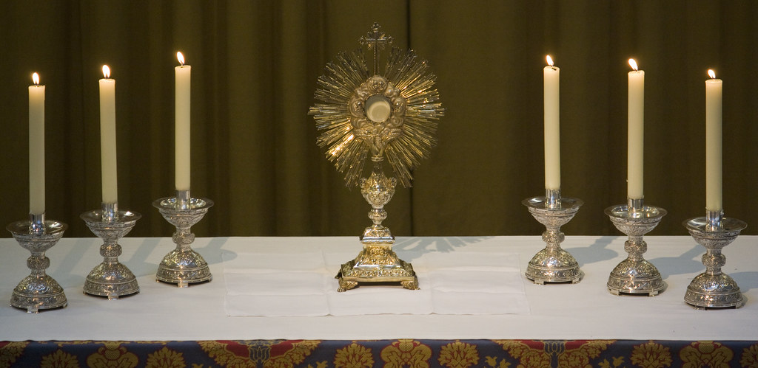
Let’s go to pray
Eucharistic Adoration is one way to grow closer to Jesus and prepare our hearts to receive him at Mass. Have you ever been to Adoration?

